Slide 1





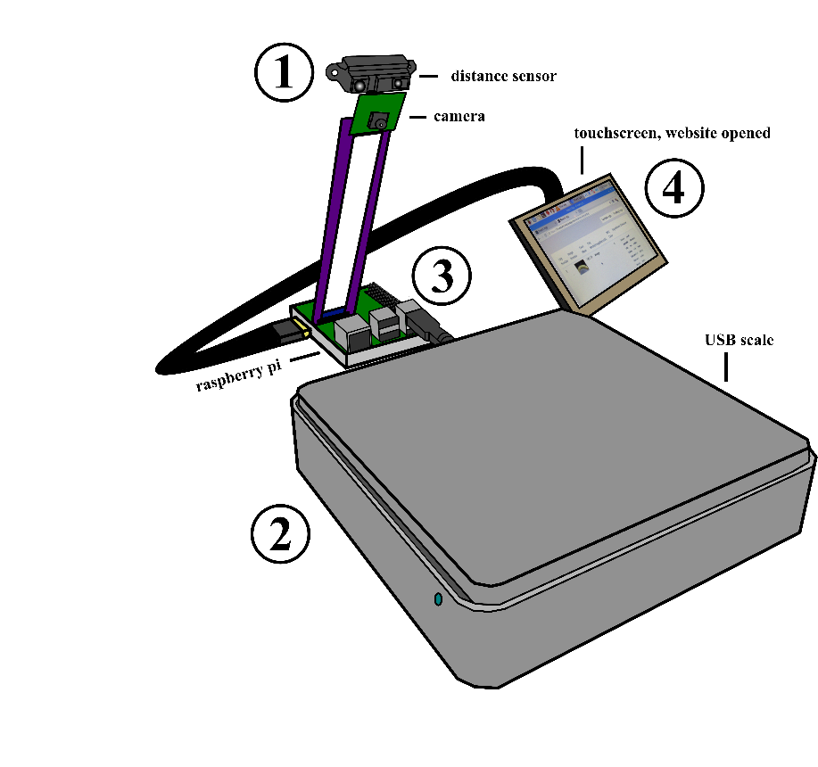
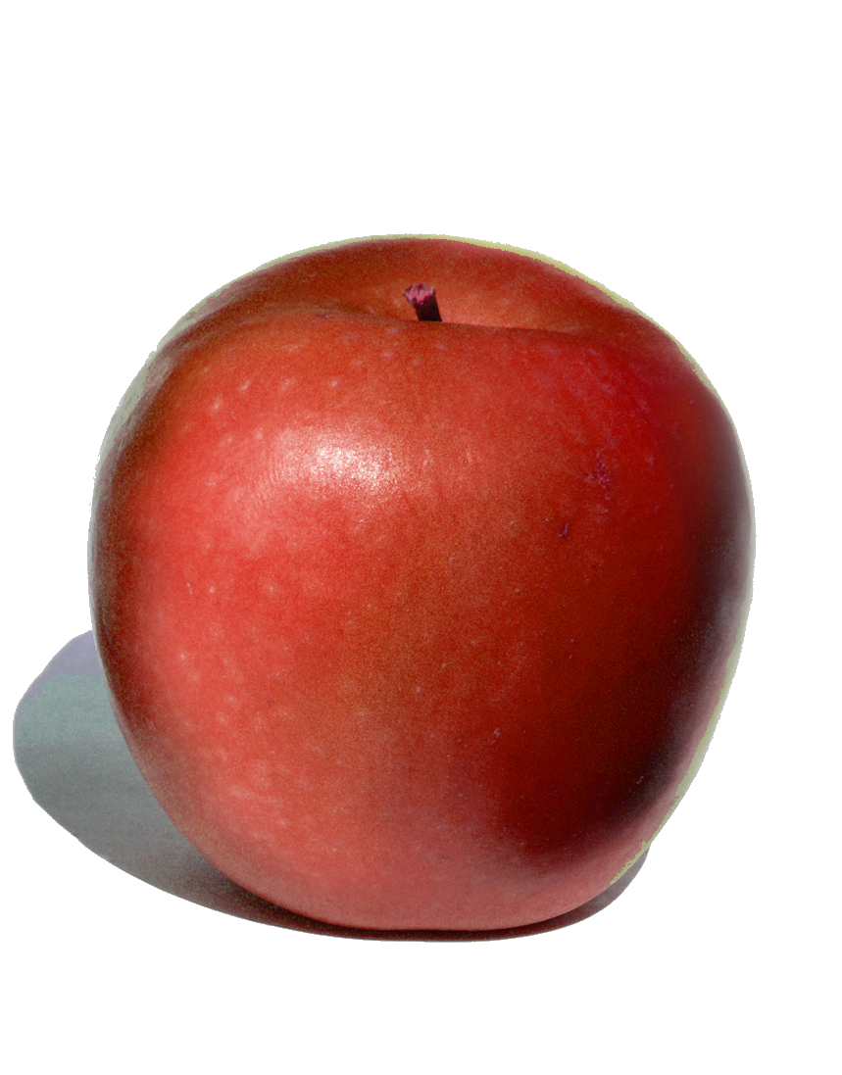
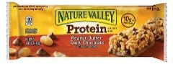
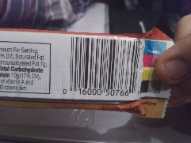
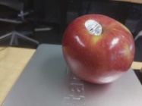
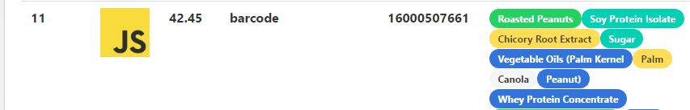
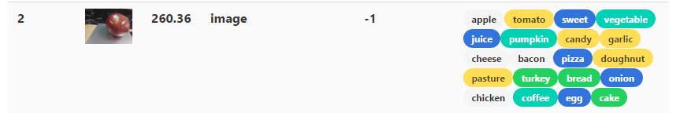
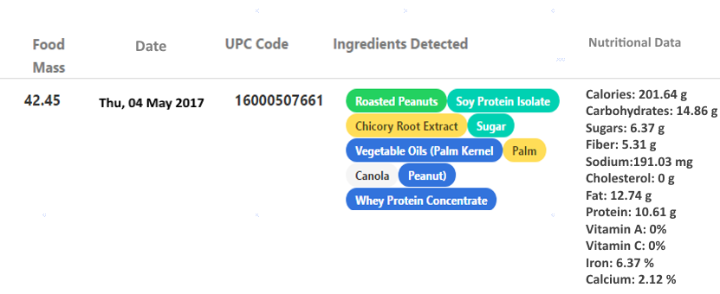
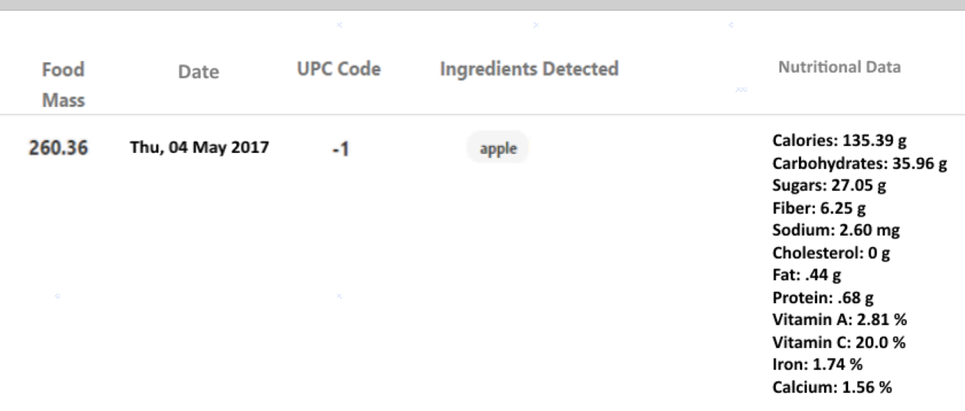
Food Diary, an Internet-of-Things Health Application
Created by Deepankar Malhan and Austin Miller
Advised by Professor Stan Kurkovsky
Additional Credits:
- Barcode Scanning
pigpio library - Pi GPIO pins
- Food-Image Analysis
- Image Manipulation
- Nutritional Data Lookup
Abstract:
- Image Hosting
Application Flow:
Results:
Many people put themselves on diets for health benefits.
With nutritional data of foods being readily available to anyone, it’s easy to know exactly what we consume each day by recording the foods we eat either by ourselves or with applications like MyFitnessPal.
However, accuracy is not maintained unless the person measures the exact amount that they eat.
With a focus on ensuring convenient and accurate food measurements, we have produced an Internet-of-Things scale that automatically retrieves and adds the nutritional data of the food placed on it by using a provided barcode or by doing food-image analysis.
This is accomplished through the use of a USB scale and a distance sensor. The data is collected and displayed by a separate website that allows users easy access to seeing what they’ve really eaten.
While waiting for food to be placed on scale, check distance sensor. If object is in front of it and in range, take photo and assume that it is of a barcode.
When mass reported by scale changes, take a photo only if a photo has not already been taken (of a barcode). Assume photo is of food. Record mass.
Situation:
Application Photo:
Objectives:
Pending Log:
Raspberry Pi uses sensors to collect and make decisions on food-data
Pi connects with external web service that stores and acts on data
Application provides user accurate method of recording daily nutrition by obtaining the mass of the food eaten and comparing it to that of the serving size.
Application allows user to add food with or without barcode
User does not need additional input devices to use application
3) If a photo of a barcode was taken, determine the UPC code of the food. If a photo of food was given, upload the image to Imgur. Send mass and UPC or Imgur ID to website.
4) All food entries are pending until user approves them. If image of food was given, website will display potential ingredients through Clarifai which the user can then select from. Then, the website will determine nutritional data by calling nutritionix with either the ingredients or the UPC.
Approved Log:
Nutritional Data
Nutritional Data
https://fd-website.herokuapp.com

